Slide 1

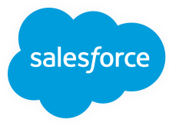
Salesforce 101

Slide 2
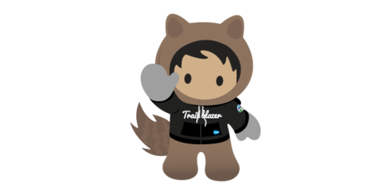
Introduction to Salesforce
Account & Contact
Activities and collaboration
Case , Service Cloud & Community
Custom objects & fields, Page Layouts and Record Types
Users, Profile, Role Hierarchy, Sharing
Configuration, Data Validation, Automation
Org hands-on - Console view, Chatter, Reports and Dashboards, Salesforce for mobile, AppExchange, Trailhead and Salesforce help

Slide 3
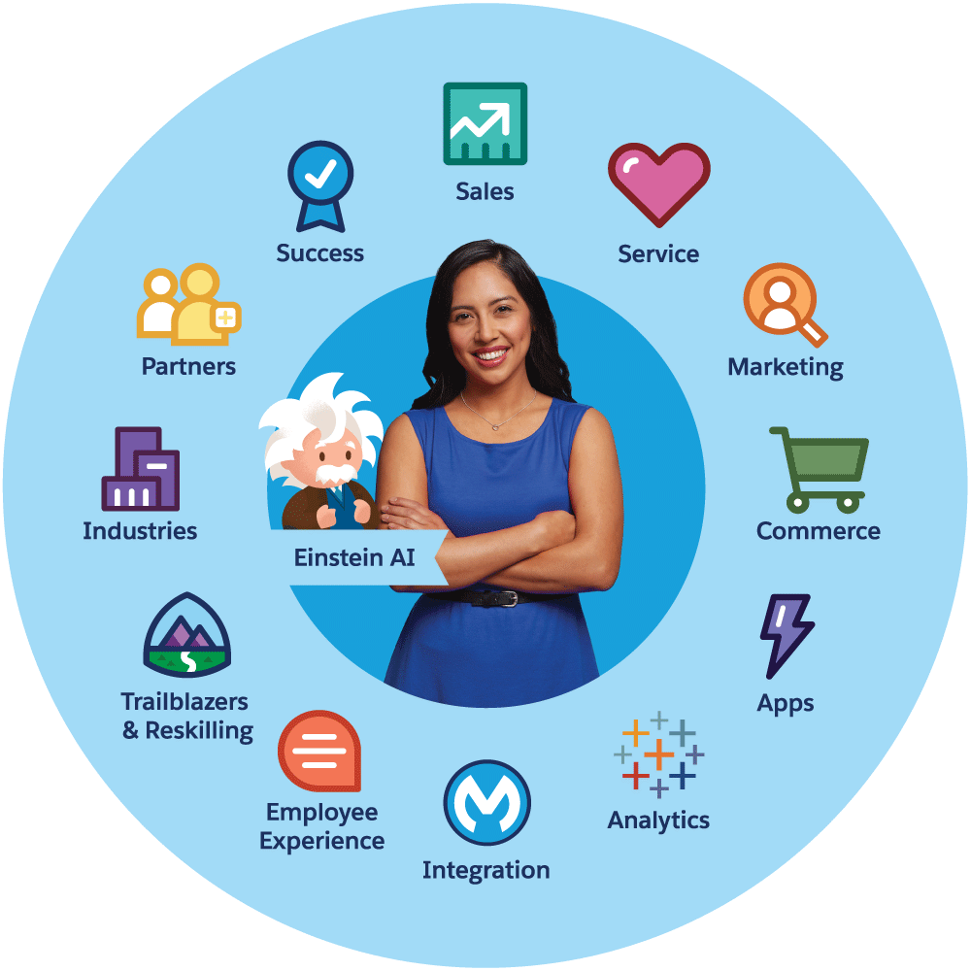

Slide 4
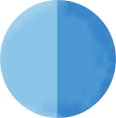



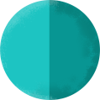


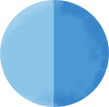
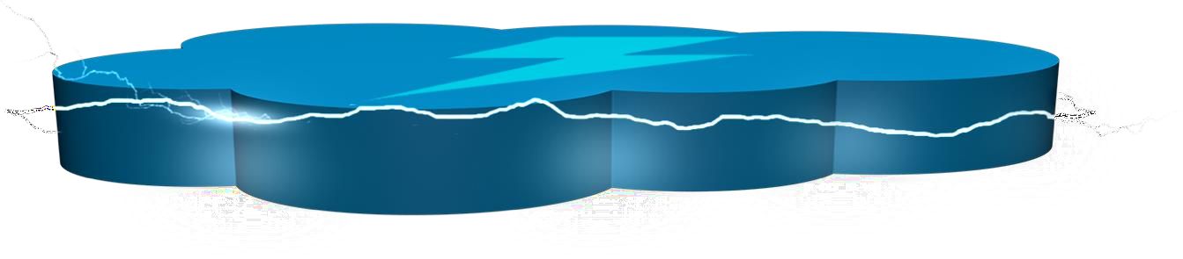



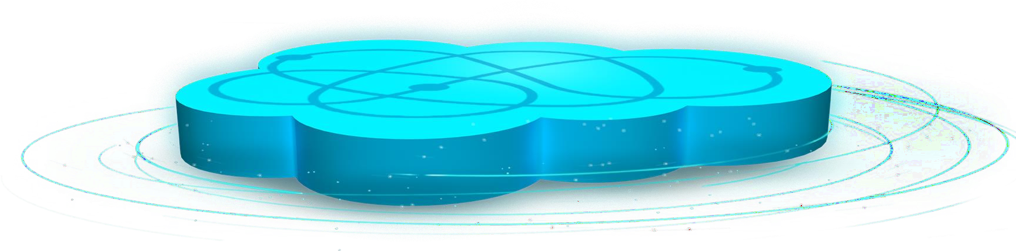


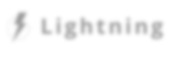



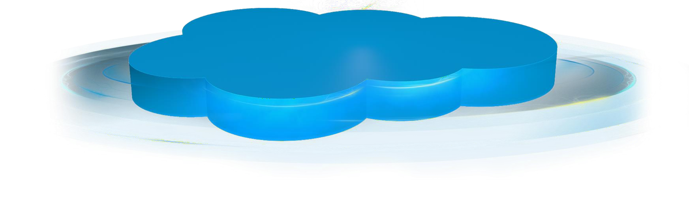




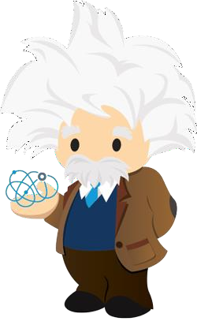


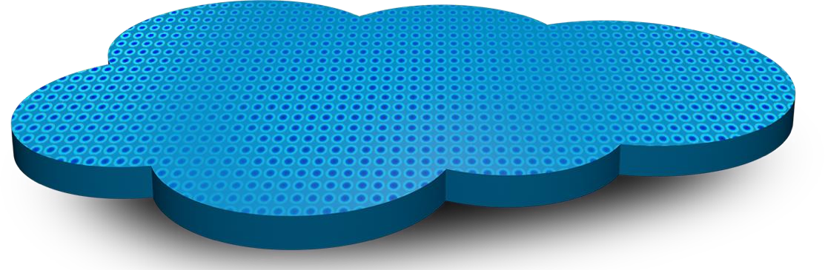




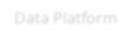

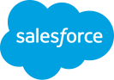
Sales
Service
Marketing Community Analytics Platform Commerce
IoT
Quip
AppExchange
Applications
Component
Exchange
Heroku
L i g htni ng
force.com
Natural Language Processing
Predictive Analytics
Machine & Deep
Learning
E i nste i n
Platform
IoT & Social Data
Thund e r
Data Platform
CRM Data

Slide 5


Object
An object lets you to store information of a particular type of information. Objects can be Accounts, Contacts, Opportunities, etc.
Overview Salesforce terminology
Tab
Tabs are displayed at the top of each Salesforce page and give access to the objects such as Accounts, Contacts, etc.
App
An app is a group of tabs that can be a Sales app, Service app etc. Apps can also be installed from the AppExchange Store
Record
A record is a group of fields storing information about a certain area. such as Accounts or Contacts
Related list
A related list is a list of records that are related to a detail record and are shown on the related tab on the record

Slide 6




Accounts
An account is an organization, company or consumer that you want to track –e.g. a customer, partner or competitor
Cases
a customer’s question, feedback, or issue. Support agents can review cases to see how they can deliver better service.
An object allows you to store information in your Salesforce organization. The object is the overall definition of the type of information you are storing. For example, the account object allow you to store information regarding customers
Contacts
Contacts are the individuals associated with your accounts. You can add personal information that you would like to track
Reports & Dashboard
A report returns a set of records that meets certain criteria. Many reports can be displayed graphically as a dashboard
Salesforce standard objects
Opportunities
Opportunities track your sales and pending deals. Products can be associated with the opportunity
Chatter
Collaborate with your colleagues, get status information about people and important projects and share information

Slide 7




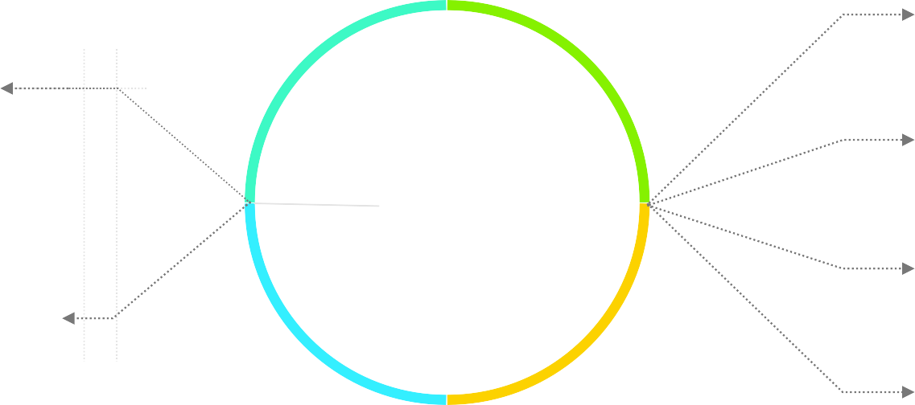






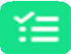






Objects chart from Accounts perspective
Mobile app
Campaigns
Files
Contacts
Notes
Products
Accounts
Activities
Opportunities
Chatter
Aircraft

Slide 8

Accounts are all types of customers (both B2B & B2C) as well as business partners/
competitors of our company. Those types are called record types.
Record types
Most popular types of accounts are:
Business Accounts
The business account is used to store all the information on business records - clients/ competitors companies, e.g.: company name, address, industry, contact information, company representatives and many more.
Person Accounts
Person accounts let you create persons/contacts that represent end customers - private clients or small enterprise. On technical level is a combination of Account and Contact object. Person accounts are listed in Accounts as well as in Contacts.
Person accounts will not be available in your Salesforce org from the beginning! They have to be enabled by Salesforce (after contacting them). It is important that once enabled they cannot be disabled.

Slide 9
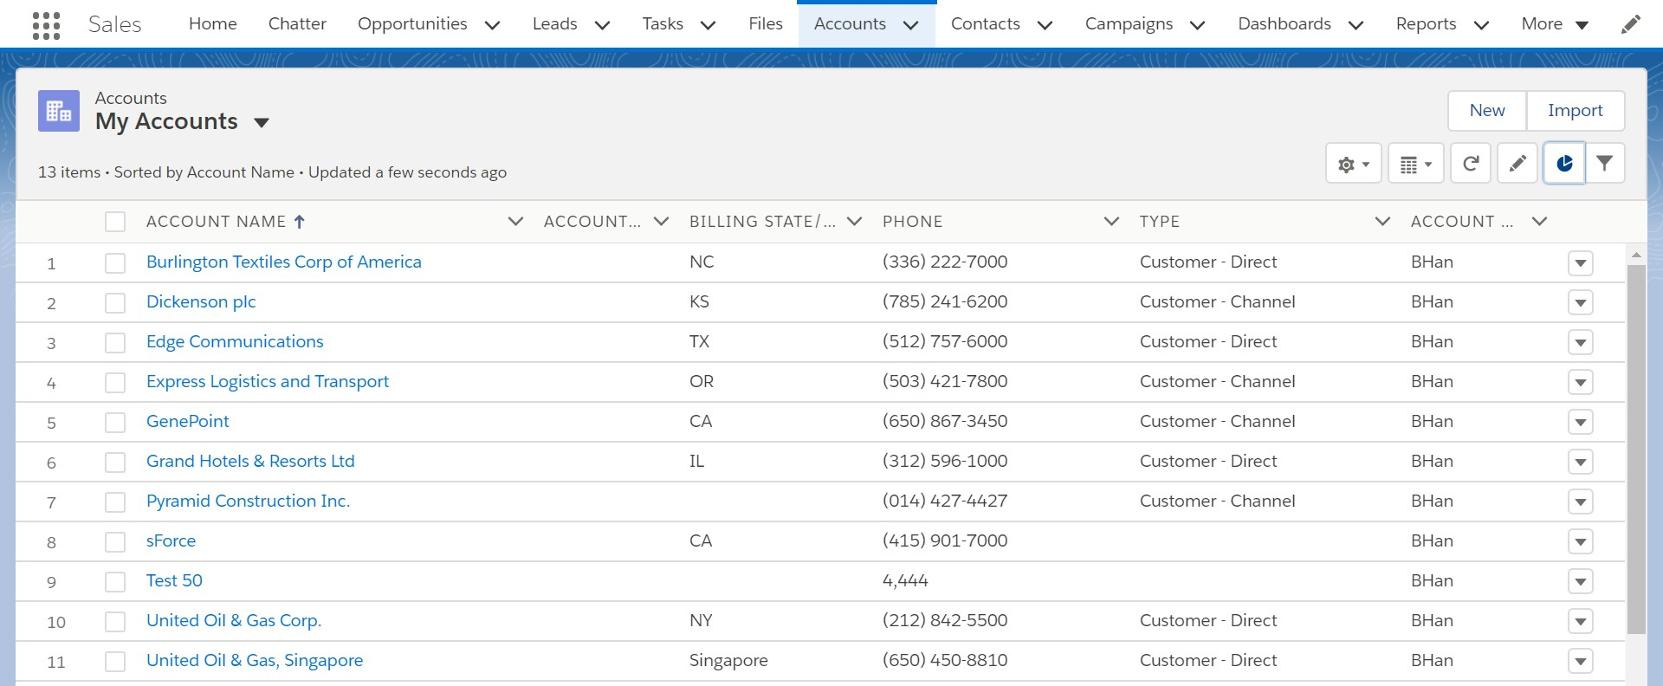
List views are fully customizable. It is possible to create new ones, edit them (e.g. edit the fields that are visible and change theirorder) or apply a filter.
Clickon Account Tab to see the list of Accounts – which
is called List View in Salesforce.
From here you can search for an Account, reviewthe details, edit an existing one/ones or create a new one.
Tab
Tab and list view
List View

Slide 10
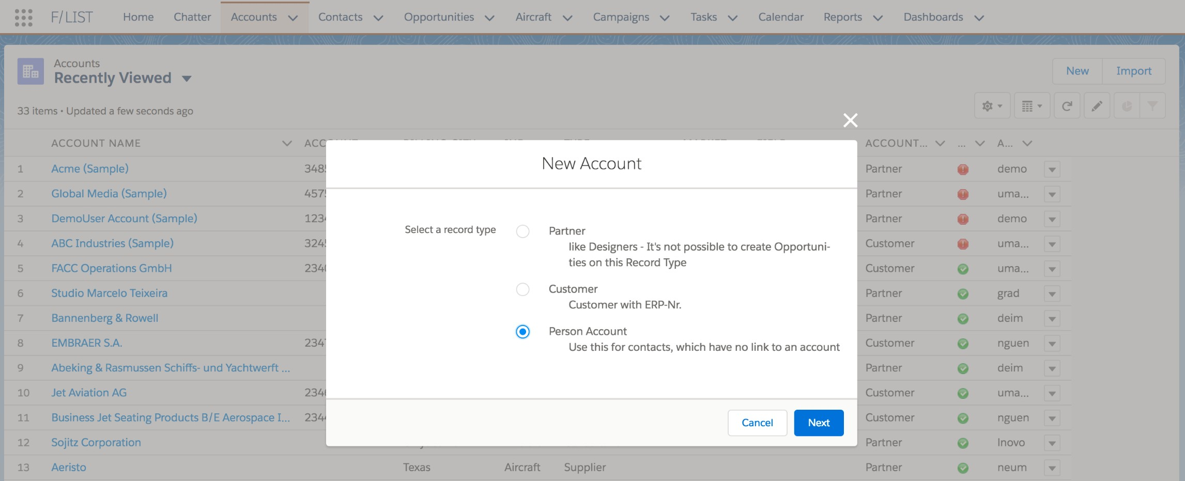
Creating an account
When creating an account, Salesforce asks which type to create. We – as Salesforce admins can define those record types as well as add/ modify the description displayed.

Slide 11









Accounts related lists
Contacts of an account
Cases
Recent Cases
Related files
Created notes
Possible duplicates

Slide 12

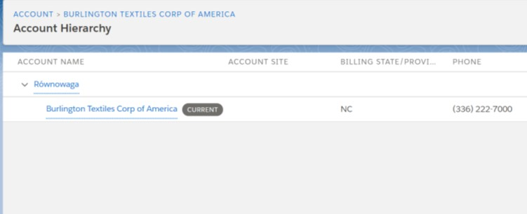
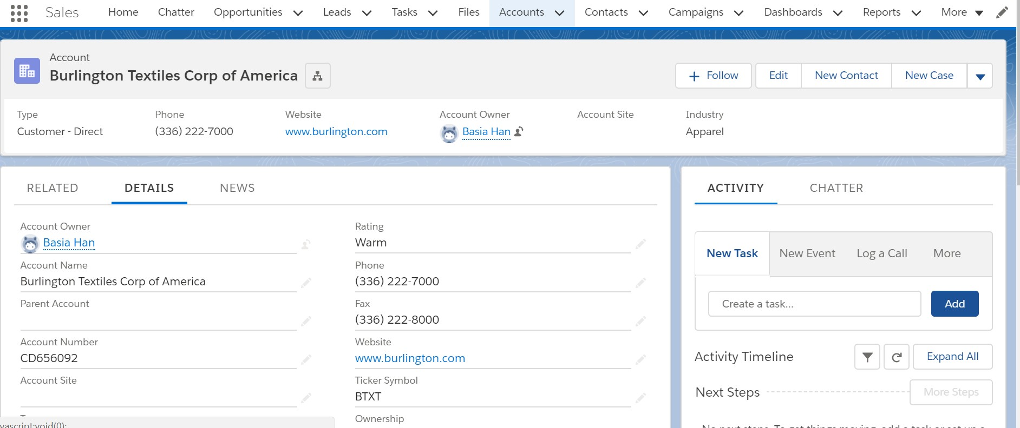

It is possible to create Account Hierarchy by adding Parent Account. Each parent can have a parent as well, all creating a hierarchy (or family).
The hierarchy itself is nicely visualized in Salesforce.

Slide 13


Contacts are persons that are representing Accounts – it can be CEO, Sales Rep, etc.
Record types
All contact information like phone number, email or birthday are stored there, we can also add a photo or any other relevant details.
Contact can also have record types but their creation is less common than for accounts. A contact, that is connected (linked) to an Account is called a contact role.

Slide 14









Contacts related lists
Opportunities that are related to that
contact
Campaigns, of which the contact is a
member
Uploaded files
Created notes
Possible duplicates

Slide 15
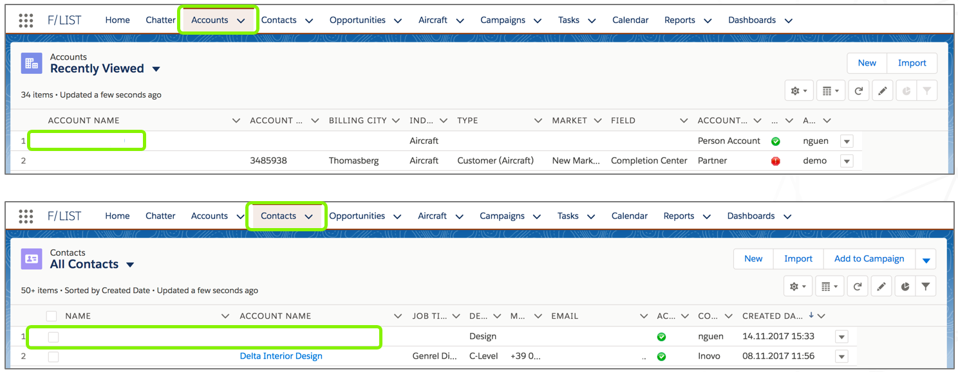
Person Accounts
Person accounts can be found both under Accounts and Contacts

Slide 16

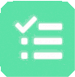













What is an Activity?
TASKS
Keep your to-do list in Salesforce and relate your tasks to records like leads, accounts, contacts, etc. Salesforce lets you quickly create and update tasks, offers prefiltered task lists and task notification options
LOG A CALL
This activity creates a completed task to document communications like a phone call. It is posted on the record page in the Activity History section for future reference
EV EN TS Use Events to track meetings with customers, prospects, and colleagues. Drill down from events to related records, feeds, files, contracts, and more. You can
also track events in reports
EMAIL
Use email activity to send and track emails directly from Salesforce. With “My email to Salesforce” Salesforce adds outgoing emails from your company-provided email address as activities to records automatically

Slide 17
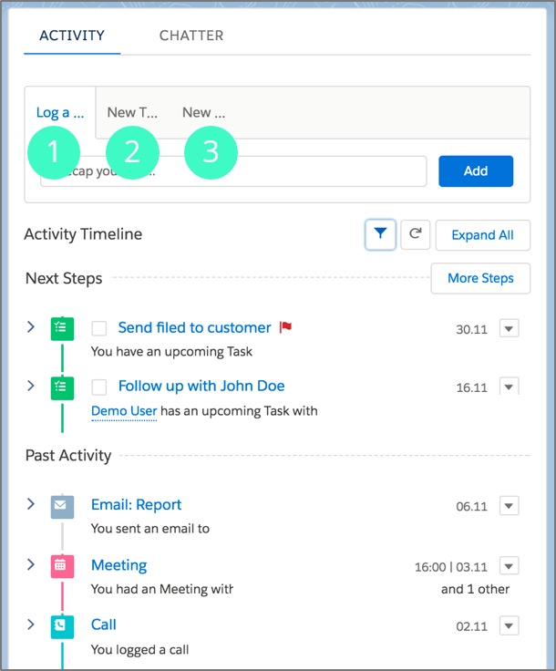
Log and create activities
Cre ate activitie s
Log a call
Create a new task
Create a new event/meeting
Activity Tim e line
Here user have all their object-related activities in a timeline view. Activities in future are shown in the section “Next Steps”, while past activities are displayed in the section “Past activity”. ktip: Click in the checkbox of an upcoming task to mark it as completed
tip
Click in the checkbox of an upcoming task to mark it as completed

Slide 18

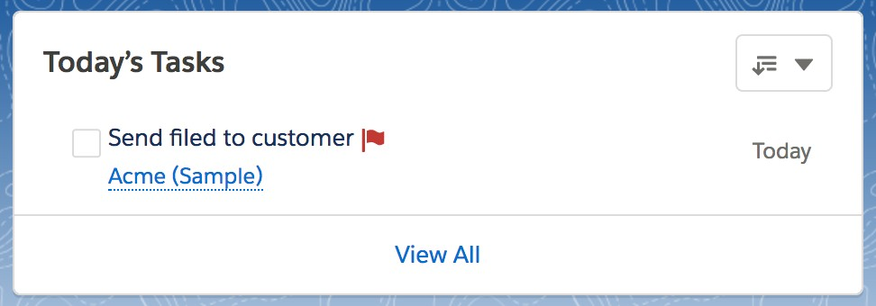
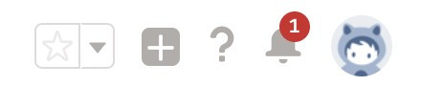
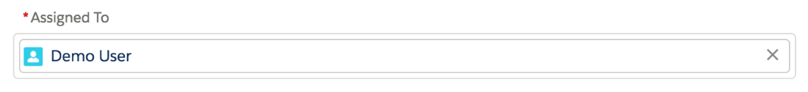
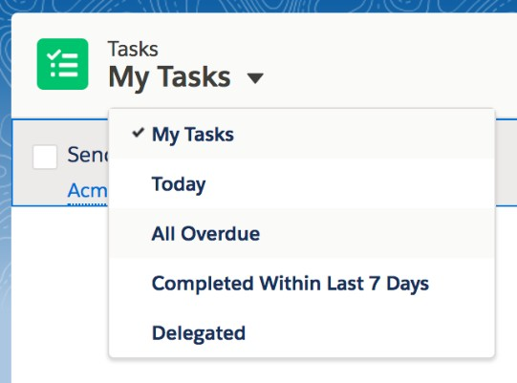
All about tasks
Today ’s Tasks
Find your tasks due today on
your Home tab
Assign Tasks to othe rs
Tasks can only have 1 assigned owner at a time, it is per default the user who creates it. Assign other users by searching and adding them to the field “Assigned To”. If assigned, the task no longer appears in your task list, but in the list view “Delegated”
Tab “ Tasks”
Browse through task list views to see
all your tasks
today ’s tasks
overdue tasks
completed tasks (within 7 days)
delegated tasks

Slide 19

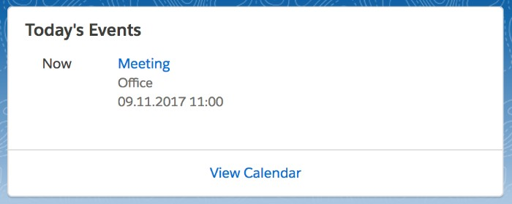
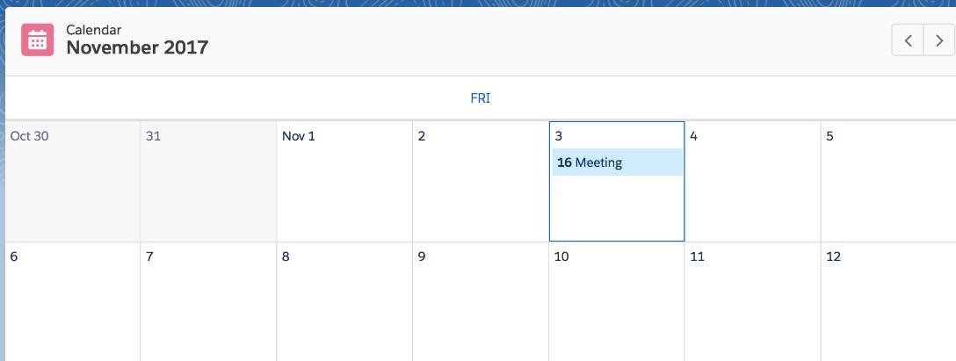
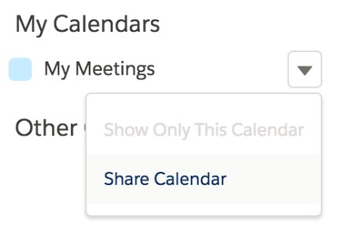
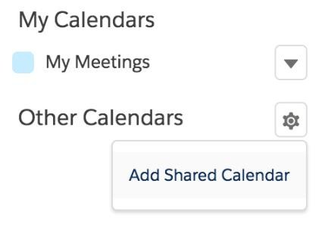
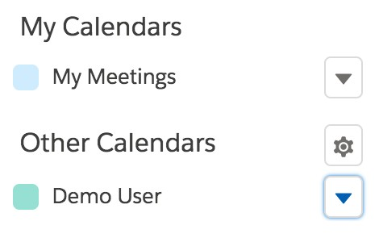
All about events & calendars
Today ’s Eve nts
Find your today’s events on your Home tab. Past events drop off the list as the day progresses
Tab “ Cale ndar”
View, create, and edit your events in a day, week, or month view. Work with all your events and create new ones. See a list of shared calendars
Share d cale ndars
Share your calendar to other users and add shared calendars from others. The section “Other Calendars” let’s you see any calendars shared by colleagues that you’ve added to your view

Slide 20


Cases are the backbone of Service Cloud.
Cases let you respond to and solve customer issues.
Cases are powerful records in Salesforce that not only track customer issues, but also show a complete view of the customer.
Customize cases to fit your business needs and ensure that your customers always receive the best service.

Slide 21



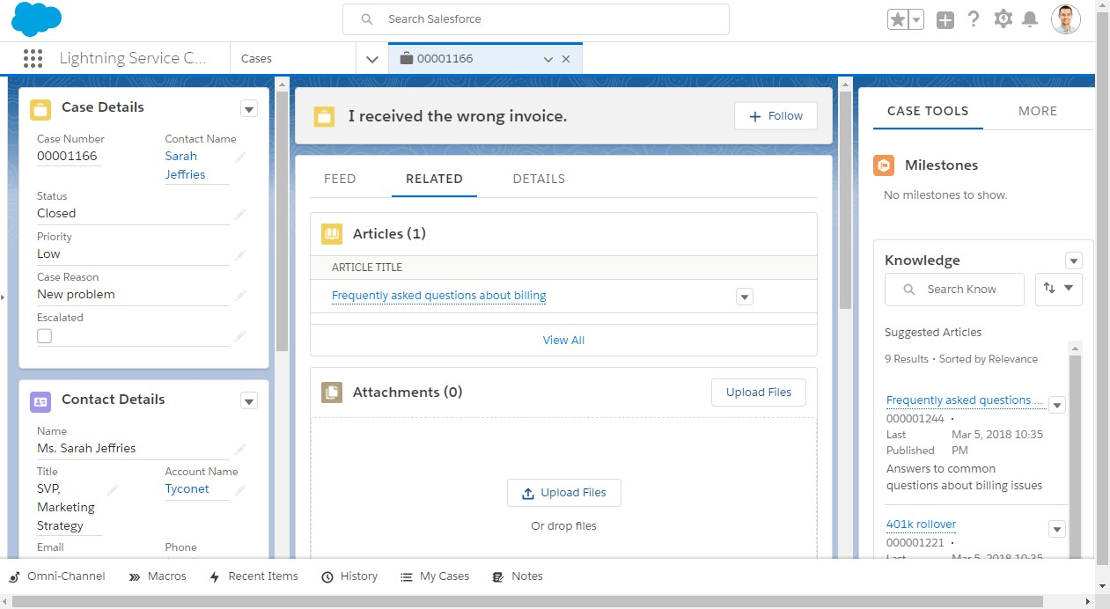
Use Lightning Service Console to view multiple case records and their related records on the same screen, and quickly work through cases from a list using split view.

Slide 22
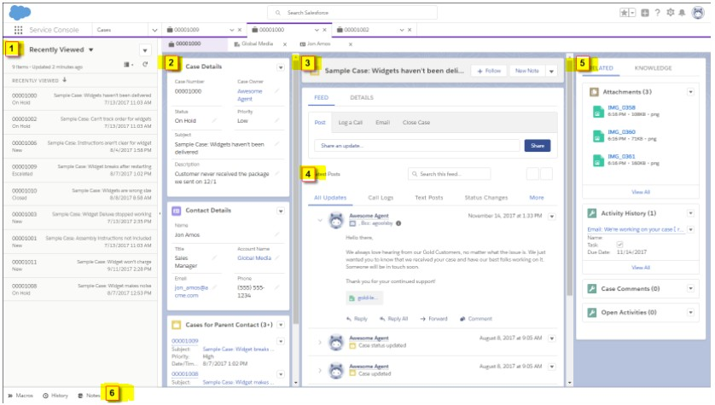
Split view shows a list view at the same time as your workspace tabs and subtabs.
A preconfigured navigation- friendly three-column layout for cases:
In the first column, related information displayed using Related Record and Related List – Single components.
The second column includes a highlights panel that’s front and center.
The compact case feed lets you see more of your case updates.
The third column includes related lists and the Knowledge component.
A preconfigured utility bar
with History and Notes.

Slide 23
Set Up and Manage Assets
Keep tabs on the products that your customers buy. Assets represent purchased or installed products, and are an essential piece of the Salesforce puzzle. You can link assets to maintenance plans, entitlements, work orders, and more so your support team can quickly assess the history of a customer’s product.
Set Up Routing with Omni-Channel
Omni-Channel routes work requests to the most available and qualified support agents in the console. You
can also provide real-time operational intelligence to support supervisors with Omni-Channel Supervisor.
Service Cloud Productivity Tools
Service Cloud offers productivity tools that save your agents time. Quick text lets agents insert predefined text, like notes, messages, and more. Macros lets agents be super users and complete repetitive tasks in one click.

Slide 24











Cases coud be created (captured) via various channels – internal and exteral:
Manually, by Salesforce users or Community users
Via mobile device
Via email (email-to-case)
Via telephone (integrated softphone, IVR)
Via Social Channels
Via web (web-to-case)
Via Live Chat or text session
Via Salesforce IoT
Via custom automation (code and non-code)

Slide 25


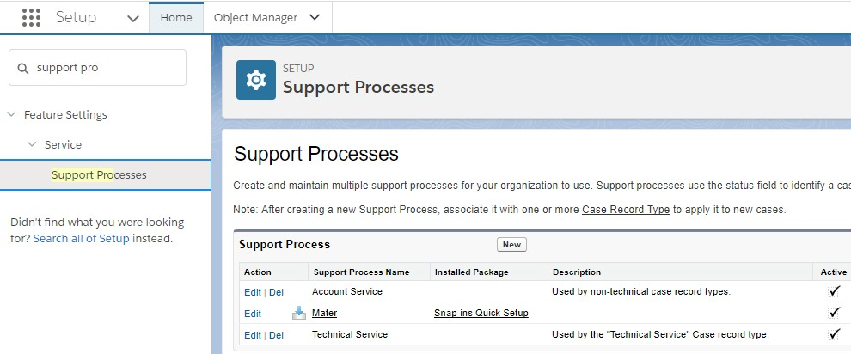
Support Process helps to define set of Case statuses as sequence of steps in Case life-cycle (analogically to Sales Process).
Support Process may be configured in combination with record types.

Slide 26


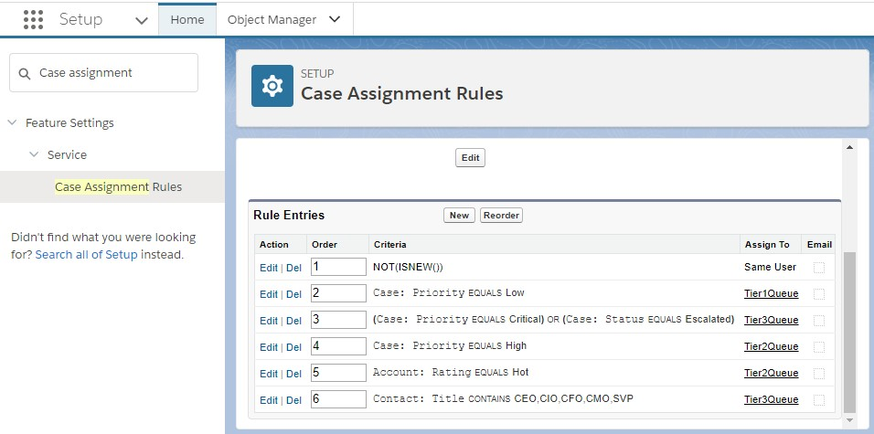
Case Assignment Rules specify the criteria used to route cases to their owners.
You can reorder rule entries on this page after you create tchem (only one rule is executed at a time).

Slide 27





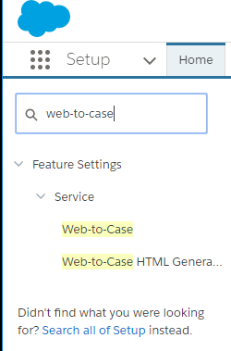
Gather customer support requests directly from your company’s website and automatically generate new cases with Web-to-Case. This can help your organization respond to customers faster.
All validations apply during case creation via Web-to-Case. You can define auto-response rules.
Up to 5,000 cases can be generated per day with Web-to-Case (Cases created over this limit will be queued).
HTML code for Web-to-Case can be generated automatically.
Enable reCAPTCHA in Web-to-Case to make it difficult for spambots to waste service representatives’ time.
Customize Support settings to select the default owner of cases.

Slide 28


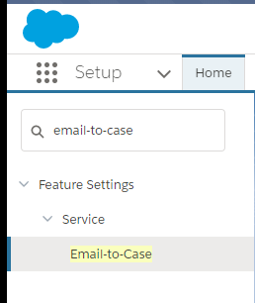
Set up Email-to-Case to efficiently resolve customer issues. Salesforce automatically creates cases and auto-populates case fields when customers send messages to the email addresses you specify.
Customer responses regarding a case are automatically associated with the original case, including any attachments the customer sends.
Case reporting measures both inbound and outbound emails by case so that you can see how many emails are exchanged before an issue is resolved.
Routing addresses allow you to create multiple email addresses from which the contents of customer emails can be converted to case fields.
Assignment Rules, Escalation Rules, Workflow Rules and Auto-Response Rules all work seamlessly with Email-to-Case.

Slide 29



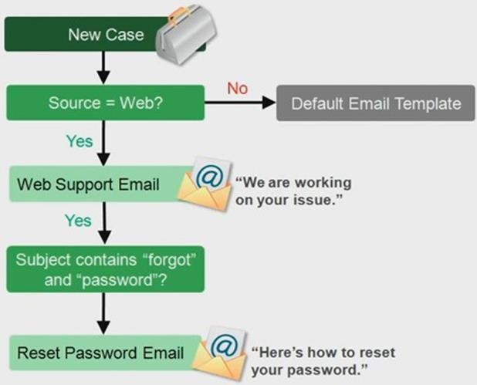
Send automatic email responses to case submissions based on the record’s attributes. Set up auto-response rules to send quick replies to customers to let them know someone at your company received their inquiry or details about their issue.
You can activate only one rule for cases at a
time.
Sales and service reps can find the email responses in the Activity History related list of the lead or contact and in the Email related list on cases.
Create auto-response rules for cases submitted through Web-to-Case (also Lead-to-Case), email- to-case (incl. On-demand).

Slide 30


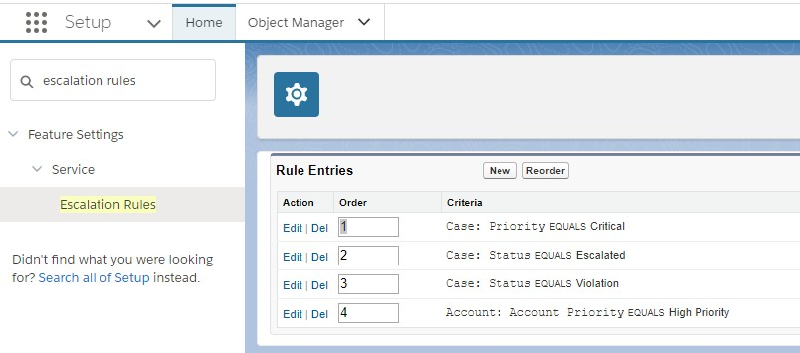
Escalation Rule assigns Case to new Owner and optionally sends notifications to apropriate users (supervisors or experts).

Slide 31
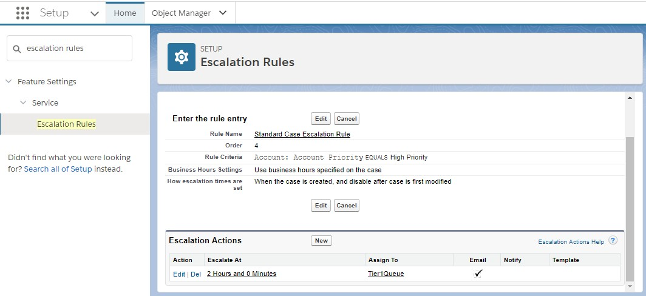
Automatically determine when cases should escalate and what actions to take.

Slide 32




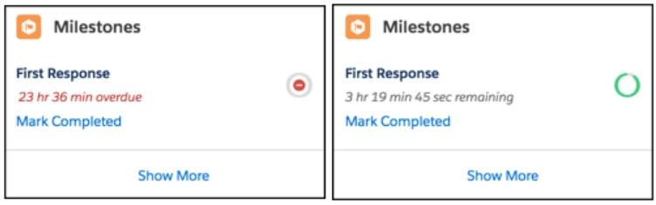
Case Milestones used with Entitlements is the latest way to ensure that Support process is being followed and all defined Service Level Agreements – SLA (like time limits to resolve case) are not ecxceeded.
Case Milestones could combine Escalation/Assignment with SLA fulfillment Functionalities.

Slide 33
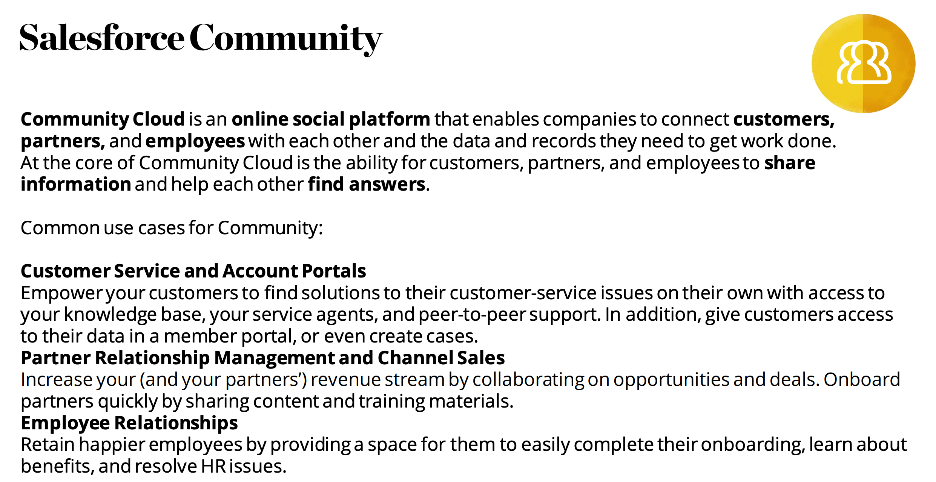

Slide 34
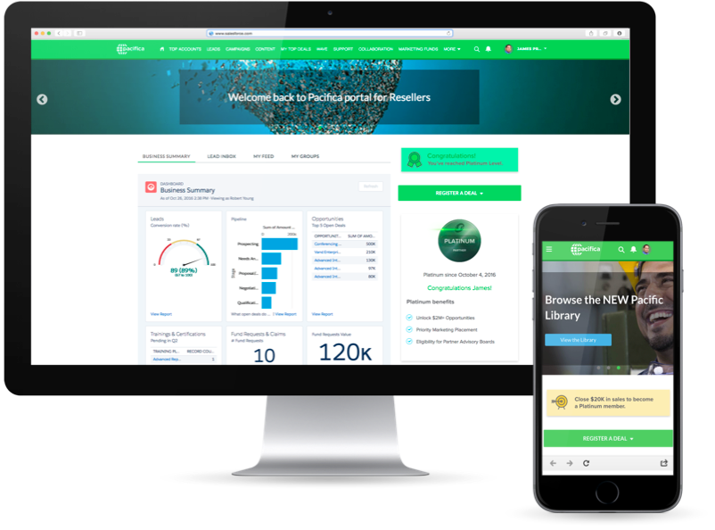
Key Featurs
Get support: open cases, start chats, raise a question
Chatter – raise questions, posts , engage your customers/partners
Share objects for read/write
Reports and Dashboard
Mobile

Slide 35


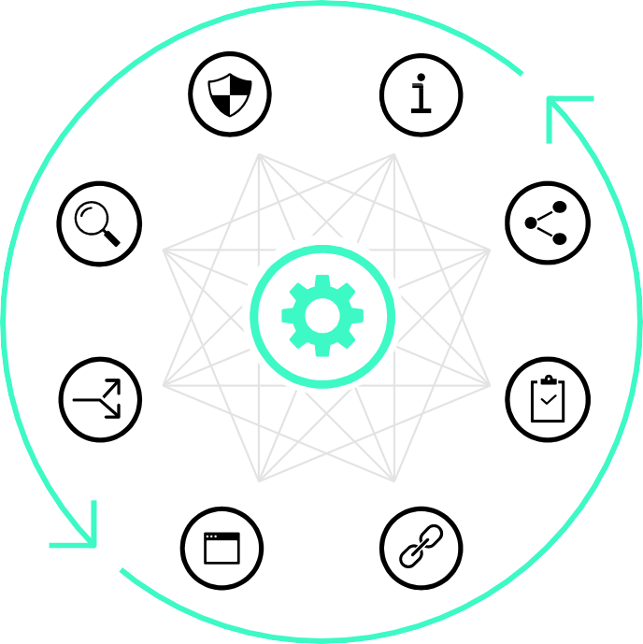



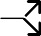


Overview
Details | Description, Label, API Name, Allow Reports, Edit and Delete (Custom Object)
Fields & Relationships | Create new fields, add field dependencies, set history tracking, click on a particular field to set field-level security
Page Layouts | Create new page layouts, rearrange fields on layout, add fields, buttons, actions and related lists, set page layout assignments
Button, Links, Actions | Create new buttons, links or actions, edit existing ones
Compact Layouts | Create new compact layouts, select fields to display, set layout assignments
Record Types | Create new record types, enable for profiles and make default if necessary, assign page layouts for record types
Search Layouts | Set layouts for searches and recently viewed-list views
Validation Rules | Create new validation rules, access and edit existing ones

Slide 36
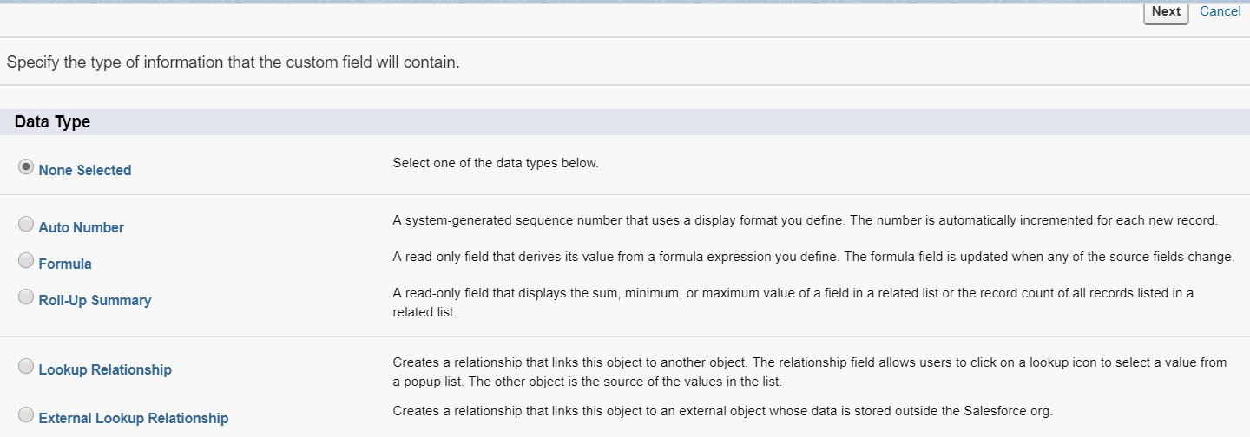

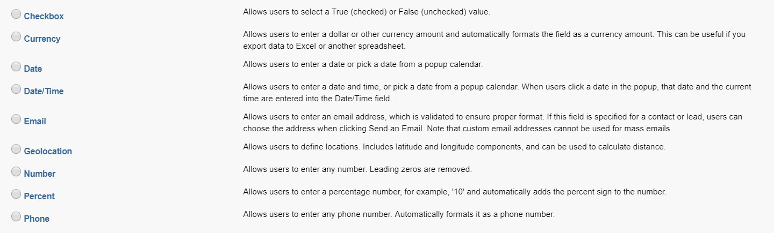
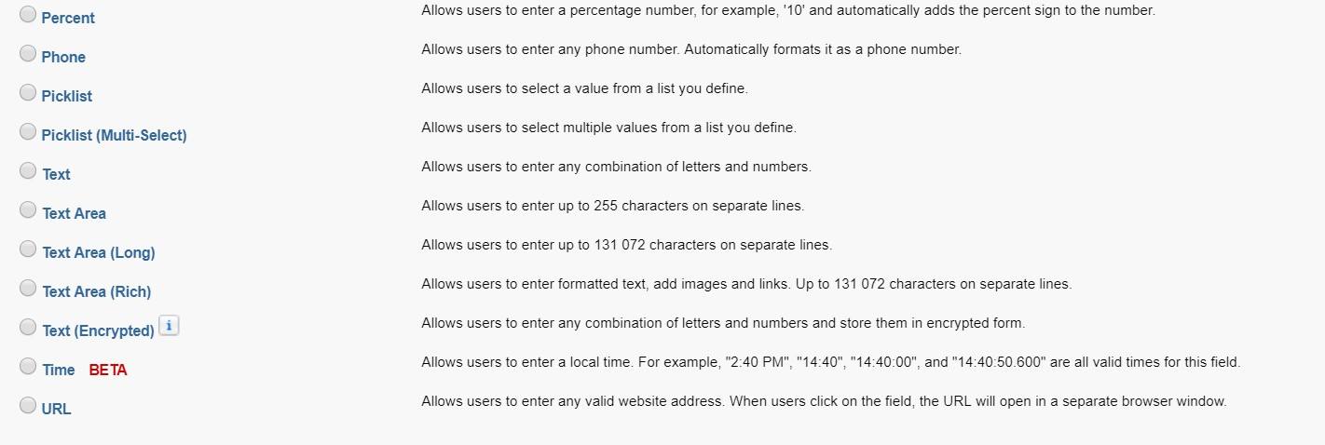
Types of custom fields
Setup | Objects and Fields | Object Manager
Represent all data formats that can be stored in Salesforce
Field descriptions can be found on field creation page, next to the field name. A couple of facts that are not mentioned there:
Auto Number -> actually can be a combination of numbers and text (max. 30 characters). Not available for external objects.
Formula -> it allows for automatic calculation of other
field values. Not available for external objects.
Currency -> a value here is automatically treated as
money value. Default currency can be defined under
„company Information”. The values are rounded in „half- to-even tie breaking”. Not available for external objects.
Master-Detail relationship -> creates a lasting relationship between two objects. It is not available on standard or external objects. It can be created between a standard and a custom object. Can not be used with the "Campaign Members" object. The Detail object inherits the same settings as the Master object.
Phone -> max 40 characters.
Text (Encrypted) -> allows storage of text encrypted
with AES algorithm.
URL-> max 255 characters.
Setup

Slide 37

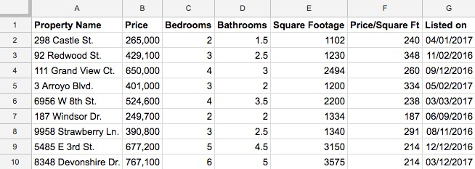

What is a custom object?
Let’s start with the data model. A data model is more or less what it sounds like. It’s a way to model what database tables look like in a way that makes sense to humans.
If you’re not familiar with databases, think about storing data in a spreadsheet. For example a property agency can use it to track all properties that are being sold. Columns can store the address, cost, and other important attributes. Rows can store this information for each property that agency is selling. Database tables are set up in a similar way.
In Salesforce, we think about database tables as objects, we think about columns as fields, and rows as records. So instead of an account spreadsheet or table, we have an Account object with fields and a bunch of identically structured records.
Each object is classified as Enterprise Application or Light Application. Light Applications do not support sharing, and do not have access to Bulk API and to Streaming API.
Setup
•

Slide 38



Viewing objects and relationships
Setup | Objects and Fields | Schema Builder
Schema Builder provides a dynamic environment for viewing and modifying all the objects and relationships in your app. This greatly simplifies the task of designing, implementing, and modifying your data model, or schema
Schema Builder lets you add the following to your schema:
Custom objects
Lookup relationships
Master-detail relationships
All custom fields except: Geolocation
Setup

Slide 39


Integrated database of aircraft

Slide 40







Related lists
Aircraft related opportunities
History of field changes

Slide 41


Set Field History
Setup | Objects and Fields | Object Manager
Select certain fields to track and display the field history in the History related list of an object. The field history data is retained for up to 18 months
Modifying any of the selected fields adds an entry to the History related list. All entries include the date, time, nature of the change, and who made the change. Not all field types are available for historical trend reporting. Certain changes, such as case escalations, are always tracked
Setup

Slide 42




Create and modify page
layouts
Setup | Objects and Fields | Object Manager
1
Display buttons and quick actions
Chose what fields are displayed for users in Salesforce
Decide how they are ordered
Add custom sections
Decide if the field is required or read-
only
Add, remove or edit related lists and
the fields displayed on them
SCROLL
2
4
5
3
SCROLL
6
Setup

Slide 43

Create and modify page
Components
Lightning Record Pages
Setup | Objects and Fields | Object Manager
Web Page Preview - Treat this as a preview of the page displayed to the user. Lightning Components can be dragged and dropped here and are editable or removable as well.
Component List - Contains all usable components for the Page. This includes standard and custom components
Component Properties - When a component is selected on the web page, its properties pop up in the right panel of the screen.

Slide 44


Manage User
Setup | Users | Users
In the user list, you can view and manage all users in your org
Reset Password for a particular or multiple user
Freeze a user to quickly restrict access to Salesforce
You can’t delete a user, but you can deactivate an account so a user can no longer log in to Salesforce
1
2 3
4
Setup

Slide 45




Setup | Users | Profiles
General information
about profiles
When creating a user, a profile must be assigned. Each user can have one profile
Standard profiles are available, custom profiles can be created
tip: Clone a standard profile and adjust it to your needs
A profile determines what a user can do
A profile describes what a user can see
Create, read, edit, delete records (can be defined per object)
Apps
Tabs
Record Types
Page Layouts
Fields
Administrative permission (customize app)
General functionality (e.g. run
report, create public list views)
Setup

Slide 46



Object Settings
Setup | Users | Profiles
Use the search box to find the
setting you need
Click on Assigned Users to view and manage all assigned users to this profile
Click on Object Settings to see the levels of permission on all objects. Select the object you want to set permissions – e.g. Accounts
Specify the type of access (Read, Create, Edit, Delete..) that users have on objects, fields, record types or tabs
1
2
3
4
Setup

Slide 47




Setup | Users | Roles
Role Hierarchy
Role Hierarchy F/LIST
Use roles together with sharing settings to determine the levels of access that users have to your Salesforce org’s data
Users at any role level can view, edit, and report on all data that’s owned by or shared with users below them in the role hierarchy (unless your Salesforce org’s sharing model for an object specifies otherwise)
To enable managers to see team
records, create a role hierarchy
🇦🇹
Austria (HQ)
🇩🇪
Germany
🇺🇸
USA
🇨🇦
Canada
🇧🇷
Brasil
Setup

Slide 48




Permission Sets
Setup | Users | Permission Sets
A permission set is a collection of settings and permissions that give users access to various tools and functions
When a new permission set is created, the administrator can set the same permissions and settings as in profiles, with one distinction, that permission sets extend users’ functional access without changing their profiles
Create permission sets to grant access among logical groupings of users, regardless of their primary job function
Each user can have multiple permission sets if required
Setup

Slide 49










Overview
Organization
Object
Record
Field
Organization | Maintain a list of authorized users, set password policies, and limit logins to certain hours and locations
Object | By setting permissions on an object, a group of users can be prevented from creating, viewing, editing, or deleting any records of that object
Record | Particular users can be allowed to view an object, but then restrict the individual object records they're allowed to see
Field | Access to certain fields can be restricted, even if a user has access to the object
Manual Sharing | Allows owners of particular records to share them with other users
Sharing Rules | Automatic exceptions to OWDs for particular groups of users, so they can get to records they don’t own or can’t normally see
Role Hierarchy | Give access for users higher in the hierarchy to all records owned by users below them in the hierarchy
OWDs | Specify the default level of access users have to each others’ records
Who Sees What video series

Slide 50





OWDs
Setup | Security | Sharing Settings
Default Access | Impact
Private | Only record owners have access to the record
Public Read Only | Every user can read all records of a particular object, but can‘t edit them. They can only edit records they own
Public Read/Write (Transfer) | Every user can read and update all records of a particular object (Transfer is only applicable to leads and cases)
Controlled by Parent | Sharing access is controlled by access to the related parent record
Administrators use organization-wide defaults to define the default sharing settings for an organization
Organization-wide defaults specify the baseline level of access that the most restricted user should have
Whereas sharing rules, roles and profiles open up access, organization- wide defaults restrict access and should be defined first
Setup

Slide 51


Sharing Rules
Setup | Security | Sharing Settings
Sharing rules represent the exceptions to your organization- wide default settings
If you have organization-wide sharing defaults of Public Read Only or Private, you can define rules that give additional users access to records they do not own
You can create sharing rules based on record owner or field values in the record
Setup

Slide 52


Approval Process
An approval process automates how records are approved in Salesforce. An approval process specifies each step of approval, including from whom to request approval and what to do at each point of the process.
It’s likely that you’re familiar with process automation in the form of workflow rules. Approvals take automation one step further, letting you specify a sequence of steps that are required to approve a record
Setup

Slide 53


Slide 54



Trusted IP Ranges
Setup | Security | Network Access
Trusted IP Ranges define a list of IP addresses from which users can log in without receiving a login challenge for verification of their identity, such as a code sent to their mobile phone
Click on New to enter a starting and ending IP Address
Setup

Slide 55



Set Passwords Policies
Setup | Security | Password Policies
Improve your Salesforce org security with password protection
Set password expire days, history, length, and complexity requirements along with other values. In addition, you can specify what to do if a user forgets their password
Setup

Slide 56



Session Security
Setup | Security | Session Settings
1
Session Settings let admins modify session security settings to specify session connection type, timeout settings, and IP address ranges to protect against malicious attacks and more
With Session Timeout, you can set the length of time after which the system logs out inactive users. Select a value between 15 minutes and 24 hours. Choose a shorter timeout period if your org has sensitive information and you want to enforce stricter security
Set Session Security Levels to restrict access to certain types of resources based on the level of security associated with the authentication (login) method for the user’s current session. By default, each login method has one of two security levels: Standard or High Assurance. You can change the session security level and define policies so specified resources are only available to users with a High Assurance level
2
Setup

Slide 57



Reduce Security Risk
Setup | Security | Health Check
Use Health Check to identify and fix potential vulnerabilities in your security settings
A summary score shows how your org measures against a security baseline, like the Salesforce Baseline Standard. Optionally, custom baselines can be uploaded
To remediate a risk, edit a particular risk by clicking on Edit, or use the button Fix Risks to quickly change settings to your selected baseline’s recommended values
Setup

Slide 58

Demo

Slide 59



Business proces automation in Salesforce can be achieved in various ways, this includes:
Validation rules in combination with formulas, Assignment Rules, Duplicate Rules, Milestones
Configuration by use of declarative tools like Process Builder, Visual Workflow and Workflow Rules or Approvals
Automation based on Apex code
Automation implementation based on simple configuration and declarative tools should be always considered before use of code.
Code based automation should always be the last resort solution!

Slide 60


Validation Rules
Setup | Object Manager | [select Object] | Validation Rules
Validation rules verify that the data a user enters in a record meets the standards you specify before the user can save the record
A validation rule can contain a formula or expression that evaluates the data in one or more fields and returns a value of “True” or “False”
Do not forget to set the validation rule
to active
Validation rules can help avoiding complex automation, but also their existence must be considered, when planning automation – Validation rules can cause conflicts and warnings during operating on data
Setup

Slide 61


Workflow Rule
A workflow rule sets workflow actions into motion when its designated conditions are met. You can configure workflow actions to execute immediately when a record meets the conditions in your workflow rule, or set time triggers that execute the workflow actions on a specific day. If a workflow action hasn’t executed yet, you can view and modify it in the workflow queue.
Workflow Action
A workflow action, such as an email alert, field update, outbound message, or task, fires when the conditions of a workflow rule are
met.
Email Alert
Email alerts are actions that send emails, using a specified email template, to specified recipients. Workflow alerts can be sent to any user or contact, as long as they have a valid email address.
Field Update
A field update is an action that automatically updates a field with a new value.
Flow
A flow is an application that can execute logic, interact with the Salesforce database, call Apex classes, and collect data from users.
You can build flows by using the Cloud Flow Designer.
Trigger Action
It is an action that launches an automation. This could be a change on data record or action could be time dependent (launches at specific point in time)
Outbound Message
An outbound message sends information to a designated endpoint, like an external service. Outbound messages are configured from Setup. You must configure the external endpoint and create a listener for the messages using the SOAP API.

Slide 62

Lightning Processes Builder
The Process Builder is a workflow tool that helps you easily automate your business processes by providing a powerful and user-friendly visual representation of your process as you build it
Visual Workflow
Visual Workflow lets you automate business processes by building flows and distributing them to the right users or systems. A flow is an application that can execute logic, interact with the Salesforce database, call Apex classes, and collect data from users. You can build flows by using the Cloud Flow Designer.
Workflow Rules
Workflow lets you automate standard internal procedures and processes to save time across your org. A workflow rule is the main container for a set of workflow instructions (workflow actions). These instructions can always be summed up in an if/then statement.
Automated Actions
An automated action is a reusable component that performs some sort of action behind the scenes—like updating a field (Field Update) or sending an email (Email Alert). Once you create an automated action, add it to a process, or other automated process.
Apex
Apex Clasess and Triggers are code that could be defined to automate business logic in Salesforce.

Slide 63


Setup | Process Automation | Workflow Rules
Workflow Rules
Setup | Process Automation | Process Builder| Workflow Actions
A workflow rule is the main container for a set of workflow instructions. These instructions can always be summed up in an if/then statement. For example: If it’s raining, then bring an umbrella
Workflow rules can be broken into two main components:
Criteria: the “if” part of the “if/then” statement. In other words, what must be true of the record for the workflow rule to execute the associated actions.
Actions: the “then” part of the “if/then” statement. In other words, what to do when the record meets the criteria.
When a record meets all the criteria for a workflow rule, that rule’s actions are executed.
Immediate actions that execute when a record matches the criteria. For example, Salesforce can automatically send an email that notifies the account team when a new high-value opportunity is created.
Time-dependent actions that queue when a record matches the criteria, and execute according to time triggers. For example, Salesforce can automatically send an email reminder to the account team if a high-value opportunity is still open ten days before the close date.

Slide 64

Setup | Process Automation | Workflow Rules
Setup | Process Automation | Process Builder| Workflow Actions
Building Workflow Rules
Set the Criteria for Your Workflow Rule.
Get started with creating a new workflow rule by selecting the object the rule relates to and configuring its criteria.
Add Automated Actions to Your Workflow Rule. Once you’ve set the criteria for your workflow rule, identify what to do when that criteria are met.
Identify Your Salesforce Org’s Default Workflow User. Select a Default Workflow User that you want Salesforce to display with a workflow rule when the user that triggered the rule is not active.
Activate Your Workflow Rule.
Salesforce doesn't trigger a workflow rule until you
activate it.

Slide 65


Processes
Setup | Process Automation | Process Builder
The Process Builder is a workflow tool that helps you easily automate your business processes by providing a powerful and user-friendly visual representation of your process as you build it
Many of the tasks you normally assign, the emails you regularly send, and other record updates are vital parts of your organization's standard processes
Instead of doing this repetitive work manually, you can configure processes to do it automatically

Slide 66

Building a Process
Setup | Process Automation | Process Builder
Define the Process Properties - The process
properties uniquely identify your process
Configure the Process Trigger - Every process includes a trigger, which tells the process when to start. How you configure that trigger depends on what type of process you’re creating
Add Process Criteria - Define the criteria that must be true before the process can execute the associated actions.
Add Actions to Your Process - After you define a criteria node, define the actions that are executed when the criteria are met. Actions are executed in the order in which they appear in the Process Builder
Execute Actions on More Than One Criteria - Choose whether to stop or continue your process after specific criteria are met and associated actions execute

Slide 67
Flows
Flow
Setup | Process Automation | Flows
Flows can either require user interaction (Interactive) —perhaps a wizard or guided UI for data entry—or run in the background on their own— perhaps something that automatically transfers records when a user’s role changes
Flows are being built based on blocks (elements like Screens and Record Creates), connectors, and resources like a variables or formulas
Cloud Flow Designer is the tool where flows are being construct. To use the Cloud Flow Designer, you need an up-to-date browser and Adobe® Flash® Player (plugin)
The real power of a flow is that it can automate updates to your organization’s records. In a flow, you can automatically look up values from records, create records, update records, delete records...
You can even combine Flows with Processes! Record change can invoke Process and process can invoke Flow
Setup

Slide 68

Building a Flow
Flow
Setup | Process Automation | Flows
Before you start creating your flow, plan it out. It’s much easier to automate a business process by using Visual Workflow when you fully understand the details of your business process.
Open the Cloud Flow Designer. From Setup, enter Flows in the Quick Find box, then select Flows, and then click New Flow.
Drag the appropriate elements onto the canvas.
Connect the elements together so that it’s clear what the order of the elements is.
Identify which element the flow should start with
when it runs.
Save any changes that you made to the flow.
Test the flow to make sure it’s working as you expect it to.
Activate the flow so that users can run it.
Distribute the flow to the appropriate users.

Slide 69


You can make your Salesforce organization even more useful and responsive to your users by developing custom
applications and integrating your external applications.
Writing Code
Write code using the Apex programming language to add business logic or use the Visualforce markup language to create the user
interface. Integrate your application using APIs and authenticate your external applications.
Debugging Your Code
Use checkpoints, logs, and the View State tab to help debug the code you’ve written.
Testing Your Changes
Testing is key to the success of your application, particularly if you deploy your application to customers. If you validate that your
application works as expected with no unexpected behavior, your customers are going to trust you more.

Slide 70





Slide 71




Flow

Slide 72





First login
Verify your account
1
Your administrator creates your user account. Salesforce sends you an automatic generated verification email (have a look at your spam folder). Click on the link in that email to verify your account
Salesforce will ask you to set up a password and security question, in case you forget your password
Click on „Change Password“ and submit the form
2
3

Slide 73

Login credentials
Login and reset password
Go to https://login.salesforce.com or your company branded domain
https://flist.my.salesforce.com
and enter your username, which is your company email address
Enter your password, which you already
set up earlier
If your forgot your password, click on the link below to create a new one
1
2
3

Slide 74


Verifying identity
Activating devices
Tips
If your are logging in from a new device, Salesforce asks to activate that device first
Salesforce sends you an activation email to the email address specified on your Salesforce user informations
When you receive the email, copy and paste the code into your browser and click “Verify”
When logging in to Salesforce for the first time, you are asked to optionally enter a phone number. If you enter one you receive your verification code by SMS. If you declined, you receive it as described per mail
You will be asked to verify your device each time you start/download a new browser or delete your cookies

Slide 75



Navigation
Navigate through Salesforce
App launcher
Tabs
Global search
Profile settings
Tip
No matte r where you are in Salesforce you will always have the navigation bar on the top of the page

Slide 76



All apps and items at a glance
3
1
2
App launcher
Browse through all of your apps (e.g. Sales, Marketing, Service..)
See all your obejcts/items at a glance
3. For Admins only: Visit the AppExchange Salesforce Store for external extensions

Slide 77

Overview of all important objects
Opportunities
Opportunities track your sales and pending deals
Dashboards
shows data from source reports as visual components which can be charts, gauges, tables or metrics
Home
Starting page where users can view todays tasks and events, recent records or open opportunities
Accounts
is an organization, company or consumer that you want to track -
e.g. customer, partner
or person account
Campaigns
Marketing initiative, such as an advertisement, direct mail, or conference, that you conduct in order to generate prospects and build brand awareness
Calender
calendar overview of your logged or shared events
Aircraft
holds a database
of aircraft
Chatter
Collaborate with your colleagues, get status information about people and important projects and share information
Reports
return a set of records that meets certain criteria and display it in organized rows and columns. Data can be filtered, grouped and displayed graphically as a chart
Contacts
are the individuals associated with your accounts
Tasks
holds all your assigned or delegated tasks, lets you log new tasks
Samples
tbd.

Slide 78



Search bar
Salesforce search bar
Enter your search terms in the header search box
Search for any record from any object (e.g. accounts, contacts…)
Type your search term and click on enter to get a detailed overview of all findings
tips
Search for any value entered into any field
Find phone numbers by entering part or all of a number
Use search operators like AND, AND NOT, OR

Slide 79




Change your personal settings
Change..
Personal informations
Language & time zone
Currency
Password
Email signature
Default record types
Chatter email notifications
..and download “Salesforce for Outlook”

Slide 80





Overview
Compact layout - displays a record’s key fields at a glance and is customizable
Related tab - shows the records related lists. You can create new related records from here
Details tab - have an overview of all details related to the record. Access general, address and system informations
Activity tab - logg activities related to the record. See and filter your upcoming and past activities in the Activity Timeline
Chatter tab - Share an update on this record, attach files and search in the feed
Action buttons - Inlcude standard buttons like Edit, Delete, Clone and custom buttons
6
1
2
4
5
3

Slide 81

Guidance For Success
Boost productivity and help reps gather complete data. Create paths to guide your users through steps of a business process, such as working an opportunity from a fresh lead to a successfully closed deal. At each step of a path, you can highlight key fields and include customized guidance for success.
1

Slide 82




Ownership
Who owns which record?
Every record has an owner
(there is no account or contact with no owner)
The ownership is shown via the record owner field
Per default, the user who has created a record automatically becomes its owner
All records can be manually assigned to another user by clicking on the change symbol on the right side of the owner‘s name.
Be aware, if you change the ownership to someone else, it might be the case
(depending on your sharing settings) that you loose access to that record
You can only change the record owner if you are currently the owner of the record

Slide 83




List views
Learn how to create your own list views
Refresh
Refresh the data seen in your listview
List view allows you to see a filtered list of records, such as contacts, accounts, or custom objects.
Filters
Click on Add Filter
Choose a field, operator and value to filter your list
Click on Save, or
add another filter
(Add a filter logic)
You can create your own personal list views
Default list view is always “Recently viewed records”
List views are available in most of the tabs/objects
New
Click on the gearwheel
and select New
Give a name and choose who can see your list view
After saving you will be
Inline editing
Edit multiple records fast and easy in one view (If the object has record types, filter one record type first to enable this feature)
redirected to the filter
section
Charts
Add a chart to your listview for visualizing your data. Salesforce made some standard charts but if you want to create your own chart..
Display
Display your list as
Table
Kanban
If you choose Kanban, select a criterium to group
click on the little gearwheel and select
New Chart
Enter a name, chart type, aggregate type, aggregate field and grouping field
Your chart is ready to display

Slide 84








What is Chatter?
Connect, engage, and motivate employees to work efficiently. Collaborate on sales opportunities, campaigns and projects
Empower your employees to do more
Provide a forum for anyone to share insights or propose new ideas. Connect product teams with direct feedback from customers and create and share polls
with
Track your team and critical projects in the mobile feed. Close cases, update opportunities, and find the latest presentations
anytime, anywhere
Share knowledge, files, and data. Connect with experts from across your organization regardless of their role or location

Slide 85

Chatter Posts
Features of Chatter
@Mention User
Use this function to address posts to specific persons or groups to bring them into the conversation. Mention user and groups by adding an at sign in front their names e.g. @JohnDoe, @SalesGroup
Chatter Groups
Chatter Groups can be created by every user and can be public, private or unlisted (accessible only by designated users). Create groups to collaborate with your teams and work together on projects
Publish posts to share an update, add links or files to it and mention user or groups. You can also ask a question or start a poll. Posts are shared with your followers or with mentioned users or groups
World’s #1 enterprise social network
Notifications
Receive email notifications from Chatter when something important happens to your feed - e.g . somebody posts a comment on your post. Let chatter send you personal digests daily, weekly, or never
Files
Files uploaded to Chatter can be found under the Files tab. Files can be shared with only specific colleagues by uploading them in the Files tab and using the Share Settings button on the file detail view
Topics
Putting a # before a keyword marks the word as a topic.
Topics can be searched for and
allow the users to find and view all related posts, regardless of where they were posted

Slide 86





Chatter posts on records
Re cord posts
Chatter post on records can be a valuable tool for tracking changes occurring with the record, as well as communicating with other team members on topics related to it
File uploads
Any file that needs to be attached to a record should be
uploaded in Chatter
Follow re cords
Follow records to see updates in your feed (“What I Follow”), including field changes, posts, tasks, and comments on records. To see how many items you’re following, view the Following list on your profile.

Slide 87


Profile
Your Chatter profile
Click on your photo
Click on your name
Edit your chatter profile
informations e.g. your photo
See your files, groups and followers in one place
Tip
Check your groups, your followers and user who you follow regularly

Slide 88



Where you enter a comment in Chatter will dictate who can (and cannot) see it
In Chatte r groups
Public groups: Anyone can see and add posts, comments or files. Anyone can join
Private groups: Only members can see and add posts. People must ask to join or be added by the group's responsible person
On a re cord
Only users with ”Read” access to
the record can see your posts
Chatte r tab
Every user who follows you can see your posts

Slide 89
Chatter vs. email
 | Chatter | Email
Instant communication with coworkers | ✓ | ✓
Attach files as supplemental info | ✓ | ✓
Communicate with multiple recipients | ✓
Communicate with entire company (without entering any names or email adresses) | ✓
View co-workers’ profiles and photos | ✓
Add comments to posts made by others | ✓
“Like” other posts and updates | ✓
Real-time Feeds to monitor people, information or conversations | ✓
Receive daily or weekly digest of every conversation about a certain topic | ✓
Create Groups surrounding topics or projects | ✓
Endless digging through archives of conversation to find the info you need |  | ✓

Slide 90
Dos and Don‘ts
Dos | Don’ts
Do participate by asking and answering questions and sharing information | Don’t post anything you wouldn’t want your HR team or executives to read
Do keep your posts brief and relevant to work | Don’t write long-winded posts
Do create private groups if necessary | Don’t use Chatter to replace an in- person conversation
Do use Chatter to address a wider audience and get feedback | Don’t post confidential information on profiles or public groups
Do use groups rather than email distribution lists for collaboration | Don’t post personal messages that aren’t relevant to your business
Do post files instead of emailing attachments | Don’t post the same thing to multiple people
Do think about who can see your post (Anyone who is following a person or a record can see its Chatter posts)

Slide 91





Learn how to use Reports & Dashboards
Dashboards represent data of a report via graphics, which allow users to see key metrics and performances quickly and comprehensively
Reports help you to access data quickly and comprehensively and is a resource component for building dashboards
Report types are templates for report creation

Slide 92

Report formats
Format
Description
Example
Illustrative
Tabular | Tabular reports are the simplest and fastest way to look at data. Similar to a spreadsheet, they simply consist of an ordered set of fields in columns. Tabular reports are best for creating lists of records ovr a list with a single grand total. | Customer Visits this month
Summary | Summary reports are similar to tabular reports, but also allow users to group rows of data, view subtotals, and create charts. They can be used as the source report for dashboard components. | Customer Visits this month grouped by sales Rep.
Matrix | Matrix reports are similar to summary reports but allow the user to group and summarize data by both rows and columns. Matrix reports have some similarities with Pivot Tables in Excel. They can be used as the source report for dashboard components. | Customer Visit count grouped by sales Rep. and account

Slide 93

Overview
Landing page
New Report - Create a new report. (Click on “New Report (Salesforce Classic)” to creat a new report on the old classic layout
New Folder - Create a new report folder. This Folder will appear in the folder list “Created by Me”
Lists of Reports and Folders - Access predefined lists of reports and folders
Reports - By default, this section shows all recent reports. Depending on which list you choose in the left sidebar (3), the respective reports will show up here

Slide 94

Report Builder
Create a new report
Fields Pane - Lists all accessible fields in the selected report type
Filters and Outline Pane -
Select filters to limit the
data shown in the report. Add groupings and choose which fields to display
Preview Pane - Contains a dynamic report preview, which allows the user to customize the report and see the immediate effect. The preview shows only a limited number (50) of records. Run the report to see all your results
Save & Run the report

Slide 95

Subscribe Reports
Subscribe to reports
On the report tab, click on the dropdown of the report you want to subscribe and click on “Subscribe"
Select the frequency of your scheduled run, the days and the time
If needed, choose other users who should receive the report. Also choose a user who should be the running user
Click “Save” to complete the
process

Slide 96

Sharing
Sharing of reports
Reports in Salesforce are shared through folders. Click on the button on the right side of the folder you want to share. Click on “Share”. (Different groups of users can be given different access rights to the same folder)
Define your sharing settings in the window that popped up
Sharing can be done based on individual Users, Roles, Roles and Subordinates or Public Groups
Search the Users, Roles or Public Groups in the Names section and select an access type. After that click on “Share”
View who can access the report in the “Who can access” section

Slide 97


Overview
Landing page
New Dashboard - Create a new Dashboard
New Folder - Create a new dashboard folder. This Folder will appear in the folder list “Created by Me”
Lists of Dashboards and Folders - Access predefined lists of dashboards and folders
Dashboards - By default, this section shows all recent dashboards. Depending on which list you choose in the left sidebar (3), the respective dashboards will show up here

Slide 98








Dashboards chart types
Funnel | Donut | Metric | Gauge
Line | Bar | Scatter | Table

Slide 99

Add components
Create a new dashboard
New component - Add a new component (Report plus chart type) to your dashboard
Add report - Select a report you
want to add to your component
Select - Click on Select to be
redirected to choosing chart types
Chart type - Choose a chart type for your report to visualize your data. Below, define axis, sort rows and add titles
Add your component to the dashboard

Slide 100


















Mobile app from Salesforce

Slide 101



The menu provides access to other sections in the mobile app. This is similar to the Navigation Bar tabs in the browser view. By clicking on a section, you can view records and update them if needed.
Click the profile icon from anywhere in the app to return to the home page.
1
2
3
Click Related to see the objects the record is associated to.
Click to access the full menu.
The menu contains frequently used items, recently used items, apps, and more. Scroll to view additional items.
Scroll to see more information.
Take actions relevant to the record.
Click Show More to edit the record.

Slide 102


Slide 103



Access Salesforce Help page: https://help.salesforce.com/home
1. Use Salesforce Documentation for finding latest detailed information on any Salesforce cloud, feature, user guide, release notes or Security compliance related issues

Slide 104


Access Help & Training by clicking on the question mark in the upper right corner of any page in Salesforce
1
Help
The Help & Training section offers context-sensitive help
for tabs or related lists your are currently working on
If no useful help is listed, you can search for articles by clicking on Search Help & Training. If the right article is found, it will tell you how to use the elements within your Salesforce application
Learn best practices by jumping directly into Trailhead. Salesforce offers some modules that might fit your need. If no useful module is listed, just click on Go to Trailhead and search through hundreds of modules to find your training
Open a case, let features be activated by an agent and get support here. You can give feedback about Salesforce, or view keyboard shortcuts in this section too
2
3
4

Slide 105







The fun way to learn Salesforce
Self-paced online learning – you can learn what you need when you need it, by choosing the appropriate trail
Learning paths – Trailhead content is arranged in a hierarchy, with three levels: trails, modules, and units, and presented in a specific sequence, so customers have a predefined path to follow, and don’t have to spend time deciding what to read and in what order
Modular and engaging content – each tutorial consists of short units, which can be read in 10-15 minutes each. The content is designed to be simple, self-contained, and directly useful, to maximize the value of the learning experience
Interactive assessments – at the end of each unit, you can take a challenge to verify what you just learned, either by answering multiple-choice questions or performing specific tasks in a development org
Gamification – we award points and badges on successful completion of units and modules, respectively. The points and badges are displayed on your user profile, so you can get recognition for your expertise

Slide 106

The fun way to learn Salesforce
If you've ever wished for an easier way to learn about Salesforce, take a look at Trailhead. Trailhead provides developers and administrators a guided, learning path through the key features of Salesforce, using a set of interactive, online tutorials.
Trailhead content blends a variety of content types and approaches to cater to all types of learners, including:
Videos
Code samples
Walkthroughs
Screenshots
Images
Tables and charts
Step-by-step instructions

